Slide 1
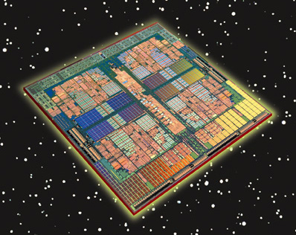
CENG334
Introduction to Operating Systems
        Multiple processor systems
        and
        Virtualization
Erol Sahin
Dept of Computer Eng.
Middle East Technical University
Ankara, TURKEY
Notes:
13/03/07

Slide 2
Computation power is never enough
Our machines are million times faster than ENIAC..
Yet we ask for more
  To make sense of universe
  To build bombs
  To understand climate
  To unravel genome
Up to now, the solution was easy:
  Make the clock run faster..
Notes:
13/03/07

Slide 3
Hitting the limits
No more.. We’ve hit the fundamental limits on clock speed:
  Speed of light: 30cm/nsec in vacuum and 20 cm/nsec in copper
  In a 10GHz machine, signals cannot travel more than 2cm in total
  In a 100GHz, at most 2mm, just to get the signal from one end to another and back
We can make computers as small as that, but we face with another problem
  Heat dissipation!
  Coolers are already bigger than the CPUs..
Going from 1MHz to 1GHz was simply engineering the chip fabrication process, not from 1GHz to 1 THz..
Notes:
13/03/07

Slide 4
Parallel computers
New approach:
  Build parallel computers
    Each computer having a CPU running at normal speeds
    Systems with 1000 CPU’s are already available..
The big challenge:
  How to utilize parallel computers to achieve speedups
    Programming has been mostly a “sequential business”
      Parallel programming remained exotic
    How to share information among different computers
    How to coordinate processing?
    How to create/adapt OSs?
Notes:
13/03/07

Slide 5
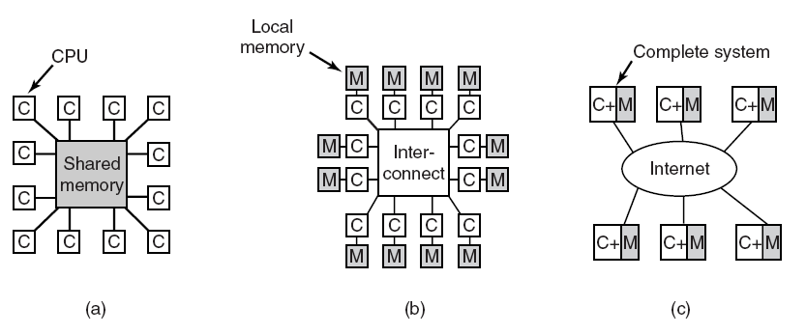
Multiple Processor Systems
(a) A shared-memory multiprocessor.
(b) A message-passing multicomputer.
(c) A wide area distributed system.
Tanenbaum, Modern Operating Systems 3 e, (c) 2008 Prentice-Hall, Inc. All rights reserved. 0-13-6006639
Notes:
13/03/07

Slide 6
Shared- memory Multiple Processor Systems
All CPUs can read and write the shared memory
Communication between CPUs through writing to and reading from the shared memory
Note that a CPU can write a value to memory and read a different value (since another process have changed it)
Tanenbaum, Modern Operating Systems 3 e, (c) 2008 Prentice-Hall, Inc. All rights reserved. 0-13-6006639
Notes:
13/03/07

Slide 7
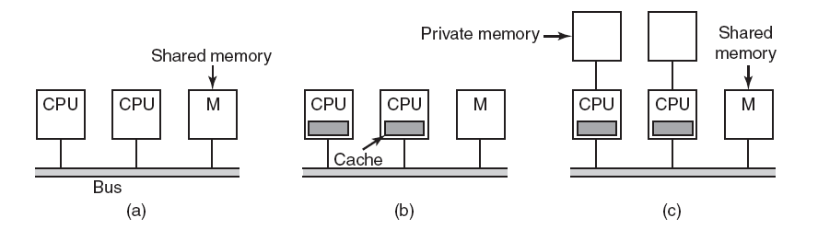
Shared-memory Multiprocessors with
Bus-Based Architectures
Without caching
With caching
With caching and private memories
Tanenbaum, Modern Operating Systems 3 e, (c) 2008 Prentice-Hall, Inc. All rights reserved. 0-13-6006639
Notes:
13/03/07

Slide 8
Shared-memory Multiprocessors with
Bus-Based Architectures
Each CPU has to check whether the bus is busy or not before accessing memory.
  OK for 3-4 CPUs, not acceptable for 32 CPUs since the bandwidth will be the limiting factor. Solution: add cache to each CPU
    Need cache-coherence protocol: if one attempts to write a word that also exist in one or more caches, then “dirty” caches need to write to the memory before the write and “clean” caches need to be invalidated,
  A better solution: use local memory and store only shared variables in the shared memory minimizing conflicts.
    Needs help from compiler
Tanenbaum, Modern Operating Systems 3 e, (c) 2008 Prentice-Hall, Inc. All rights reserved. 0-13-6006639
Tanenbaum, Modern Operating Systems 3 e, (c) 2008 Prentice-Hall, Inc. All rights reserved. 0-13-6006639
Notes:
13/03/07

Slide 9
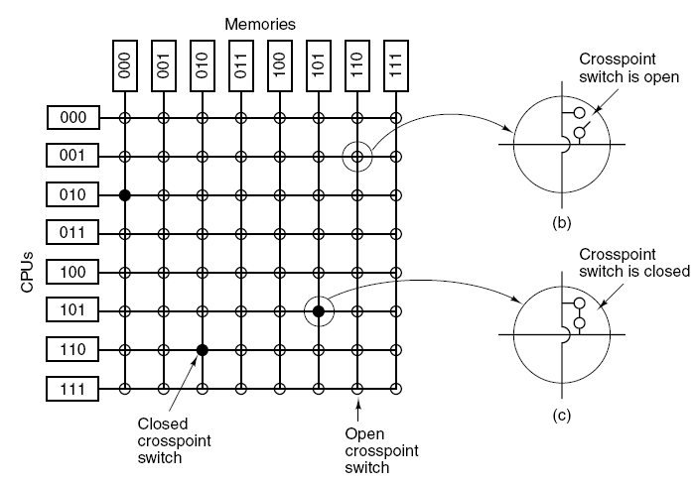
UMA Multiprocessors
Using Crossbar Switches
Better connection performance than single-bus systems.
Guarantee one connection per memory
Not completely scalable though
Tanenbaum, Modern Operating Systems 3 e, (c) 2008 Prentice-Hall, Inc. All rights reserved. 0-13-6006639
Notes:
13/03/07

Slide 10
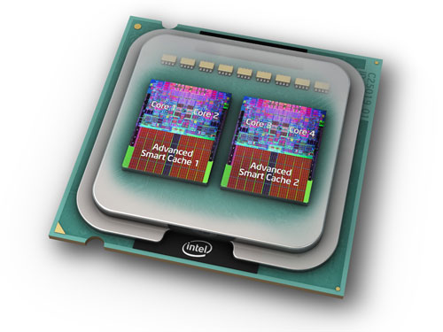
Multicore chips
Recall Moore’s law:
  The number of transistors that can be put on a chip will double every 18 months!
    Still holds! 300 million transistors on an Intel Core 2 Duo class chip
  Question: what do you do with all those transistors?
    Increase cache.. But we already have 4MB caches.. Performance gain is little.
    Another option: put two or more cores on the same chip (technically die)
  Dual-core and quad-core chips are already on the market
  80-core chips are manufactured.. More will follow.
Notes:
13/03/07

Slide 11
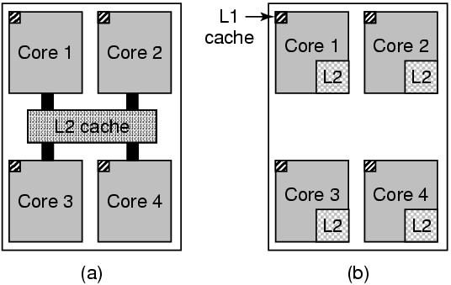
Multicore Chips
Shared L2:
Good for sharing resources
Greedy cores may hurt the performances of others
Intel style
AMD style
Intel style
(a) A quad-core chip with a shared L2 cache.
(b) A quad-core chip with separate L2 caches.
Tanenbaum, Modern Operating Systems 3 e, (c) 2008 Prentice-Hall, Inc. All rights reserved. 0-13-6006639
Tanenbaum, Modern Operating Systems 3 e, (c) 2008 Prentice-Hall, Inc. All rights reserved. 0-13-6006639
Notes:
13/03/07

Slide 12
Multiprocessor OS types
In a multiprocessor, there are multiple copies of the “CPU resource”.
But this complicates the design of the OS since the CPUs should coordinate their processing.
Three major types:
Each CPU has its own OS
Master-Slave multiprocessor
Symmetric multiprocessors
Notes:
13/03/07

Slide 13
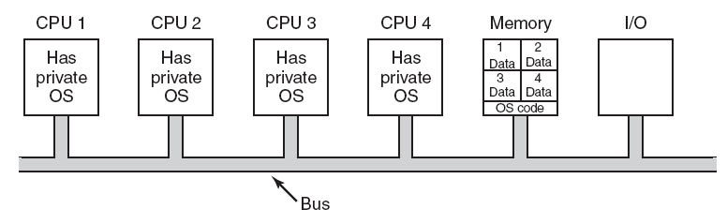
Each CPU Has Its Own
Operating System
Partitioning multiprocessor memory among four CPUs, but sharing a single copy of the operating system code.
The boxes marked Data are the operating system’s private data for each CPU.
Statically divide memory into partitions and give each CPU its own private memory and its own copy of OS.
  n CPU’s operate as n independent computers.
    This approach can be optimized by sharing the OS code but not the OS data structures.
    Better than having n computers, since all disks and I/O devices are shared.
    Communication between processes running on different CPU’s can occur through memory.
Tanenbaum, Modern Operating Systems 3 e, (c) 2008 Prentice-Hall, Inc. All rights reserved. 0-13-6006639
Notes:
13/03/07

Slide 14
Each CPU Has Its Own
Operating System
Four main aspects of this design:
  When a process makes a system call, the call is caught and handled by its own CPU using the data structures in that copy of OS.
  No sharing of processes. Each CPU does its own scheduling.
    If a user logs on to CPU1, then all his processes run on CPU1
  No sharing of pages.
    It may happen that CPU1 is paging continuously while CPU2 has free pages.
  If all OS’s maintain a buffer caches of recently used disk blocks, then inconsistent results can happen.
    Buffer caches can be eliminated. But this hurts the performance.
Good approach for fast porting. Rarely used any more.
Tanenbaum, Modern Operating Systems 3 e, (c) 2008 Prentice-Hall, Inc. All rights reserved. 0-13-6006639
Tanenbaum, Modern Operating Systems 3 e, (c) 2008 Prentice-Hall, Inc. All rights reserved. 0-13-6006639
Notes:
13/03/07

Slide 15
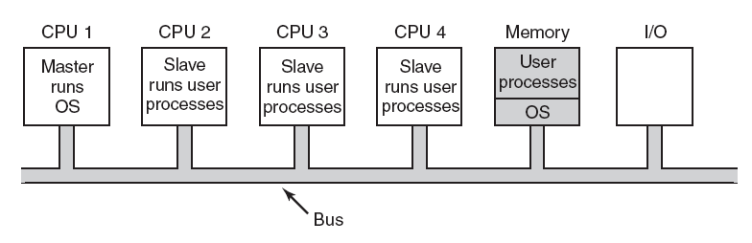
Master-Slave Multiprocessors
A single copy of OS (and its data structures) running on CPU1.
  Solves many of the problems of the previous approach.
    When a CPU becomes idle it can ask the OS to get more processes.
    Pages can be allocated among all the processes dynamically.
    There is only one buffer cache. No inconsistency problem.
All system calls are redirected to CPU1 for processing.
  The CPU1 can get overloaded with system calls
    Good for few CPUs, but not scalable.
Tanenbaum, Modern Operating Systems 3 e, (c) 2008 Prentice-Hall, Inc. All rights reserved. 0-13-6006639
Tanenbaum, Modern Operating Systems 3 e, (c) 2008 Prentice-Hall, Inc. All rights reserved. 0-13-6006639
Notes:
13/03/07

Slide 16
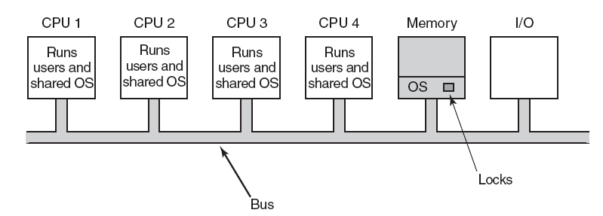
Symmetric Multiprocessors
One copy of OS in memory but all CPUs can run it.
  When a system call is made, that CPU traps to the kernel and processes it.
  Balances processes and memory dynamically, since the OS data structures are shared.
  Eliminates the master CPU bottleneck.
  But, synchronization should be implemented.
    Remember race conditions?
Tanenbaum, Modern Operating Systems 3 e, (c) 2008 Prentice-Hall, Inc. All rights reserved. 0-13-6006639
Tanenbaum, Modern Operating Systems 3 e, (c) 2008 Prentice-Hall, Inc. All rights reserved. 0-13-6006639
Notes:
13/03/07

Slide 17
Symmetric Multiprocessors
Synchronization problems
  Two CPU’s picking the same process to run
  Two processes claiming the same free memory page
Solution: Use synchronization primitives
  Easy solution:
    Associate a mutex with the OS, making the OS code one big critical region
    Each CPU can run in kernel mode, but once at a time.
    It works, but is almost as bad as the master-slave model.
    But there is a way out!
Tanenbaum, Modern Operating Systems 3 e, (c) 2008 Prentice-Hall, Inc. All rights reserved. 0-13-6006639
Tanenbaum, Modern Operating Systems 3 e, (c) 2008 Prentice-Hall, Inc. All rights reserved. 0-13-6006639
Notes:
13/03/07

Slide 18
Symmetric Multiprocessors
Many parts of the OS are independent of each other.
  One CPU can run the scheduler, while the other is handling a filesystem call, and a third one is processing a page fault.
  Need to split OS into multiple independent critical regions that do not interact with each other.
    Each critical region can have its own lock.
  However some tables are used by multiple critical regions
    Process table: needed for scheduling but also for the fork system call
Tanenbaum, Modern Operating Systems 3 e, (c) 2008 Prentice-Hall, Inc. All rights reserved. 0-13-6006639
Tanenbaum, Modern Operating Systems 3 e, (c) 2008 Prentice-Hall, Inc. All rights reserved. 0-13-6006639
Notes:
13/03/07

Slide 19
Symmetric Multiprocessors
The challenge:
  is not about writing the OS code for such a machine.
  is about splitting the OS code into critical regions that can be executed concurrently by different CPUs.
    All the tables used by multiple critical regions should be associated with a mutex
    And all the code using the table must use the mutex correctly.
    Deadlocks pose a big threat. If two critical regions both need table A and table B, then a deadlock will happen sooner or later.
      Recall solution: Number the tables, and acquire them in increasing order.
Tanenbaum, Modern Operating Systems 3 e, (c) 2008 Prentice-Hall, Inc. All rights reserved. 0-13-6006639
Notes:
13/03/07

Slide 20
Multiprocessor Synchronization
Multiprocessors need synchronization
  E.g. using mutexes to lock and unlock for accessing kernel data structures
  Synchronization is difficult to implement on a uniprocessor machine. For instance
    On a uniprocessor a CPU can disable interrupts
    On a multiprocessor, disabling interrupts affects only that CPU, all other CPUs can still continue to access memory.
Recall TSL (test_and_set) instruction
  Read a word from memory and store it in a register. Simultaneously it writes a 1 into the memory word.
    Requires two bus cycles to perform memory read and write.
    Not a problem on a uniprocessor machine, but need extra support in a multiprocessor machine.
Tanenbaum, Modern Operating Systems 3 e, (c) 2008 Prentice-Hall, Inc. All rights reserved. 0-13-6006639
Notes:
13/03/07

Slide 21
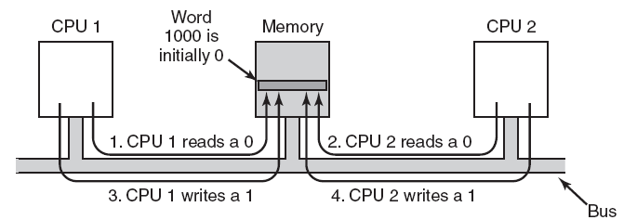
Multiprocessor Synchronization
The TSL instruction can fail if the bus cannot be locked. These four steps show a sequence of events where the failure is demonstrated.
The hardware must support the TSL instruction to lock the bus, preventing other CPUs access, then do both memory accesses, and then unlock the bus.
  Guarantees mutual exclusion, but
    the other CPUs are kept in spinlocking wasting not only CPU time but also putting load on the bus and the memory.
Tanenbaum, Modern Operating Systems 3 e, (c) 2008 Prentice-Hall, Inc. All rights reserved. 0-13-6006639
Notes:
13/03/07

Slide 22
Multiprocessor Synchronization
Can we solve the problem (the bus load part) through caching?
  In theory, once the CPU reads the lock word, it should get a copy in its cache.
  All subsequent reads can be obtained from the cache.
    Spinlocking on the cache, frees the bus load
  When the CPU holding the lock writes to the lock, all the cached copies of other CPUs gets invalidated, requiring the CPU fetch the new copy.
    Still has other problems, though..
Tanenbaum, Modern Operating Systems 3 e, (c) 2008 Prentice-Hall, Inc. All rights reserved. 0-13-6006639
Notes:
13/03/07

Slide 23
Spinning versus switching
Spinning for a lock is not the only option.
In a multiprocessor system, the CPU can decide to switch to a different thread to run, instead of spinning for a lock.
  Penalty paid:
    An extra context switch
    Invalidated cache
Both options are doable.
  But when to do which is subject to research..
Tanenbaum, Modern Operating Systems 3 e, (c) 2008 Prentice-Hall, Inc. All rights reserved. 0-13-6006639
Notes:
13/03/07

Slide 24
Multiprocessor scheduling
On a uniprocessor:
  Which thread should be run next?
On a multiprocessor:
  Which thread should be run on which CPU next?
What should be the scheduling unit?
  Threads or processes
    Recall user-level and kernel-level threads
  In some systems all threads are independent,
    Independent users start independent processes
  in others they come in groups
    Make
    Originally compiles sequentially
    Newer versions starts compilations in parallel
      The compilation processes need to be treated as a group and scheduled to maximize performance
Tanenbaum, Modern Operating Systems 3 e, (c) 2008 Prentice-Hall, Inc. All rights reserved. 0-13-6006639
Notes:
13/03/07

Slide 25
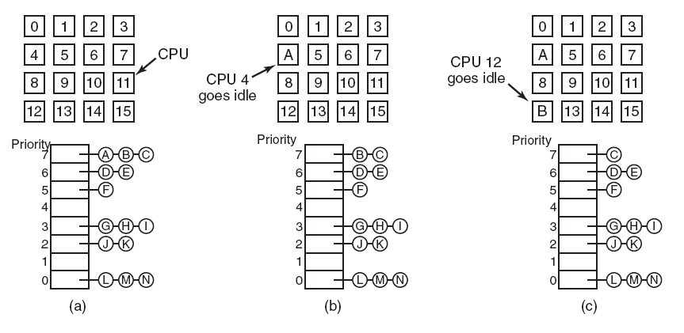
Timesharing
Scheduling independent threads
  Have a single system-wide data structure for ready threads
    Either as a single list
    Or as a set of lists with different priorities
  Automatic load balancing
  Affinity scheduling
Tanenbaum, Modern Operating Systems 3 e, (c) 2008 Prentice-Hall, Inc. All rights reserved. 0-13-6006639
Notes:
13/03/07

Slide 26
Timesharing
Scheduling independent threads
  Have a single system-wide data structure for ready threads
    Either as a single list
    Or as a set of lists with different priorities
  Automatic load balancing
  Affinity scheduling
Tanenbaum, Modern Operating Systems 3 e, (c) 2008 Prentice-Hall, Inc. All rights reserved. 0-13-6006639
Notes:
13/03/07

Slide 27
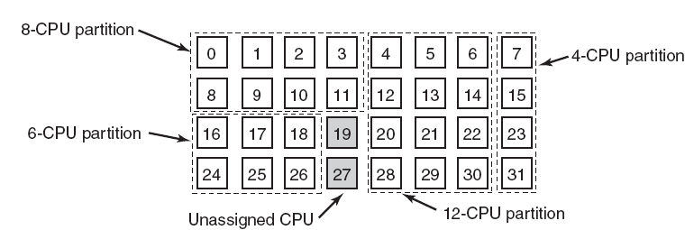
Space Sharing
Scheduling multiple threads that depend on each other at the same time across multiple CPU’s
  Partition the set of CPUs into groups
  Run each process in that particular partition
  Can use one CPU per thread, eliminating context switches
  Wastes CPU power when the thread goes for I/O
Tanenbaum, Modern Operating Systems 3 e, (c) 2008 Prentice-Hall, Inc. All rights reserved. 0-13-6006639
Notes:
13/03/07

Slide 28
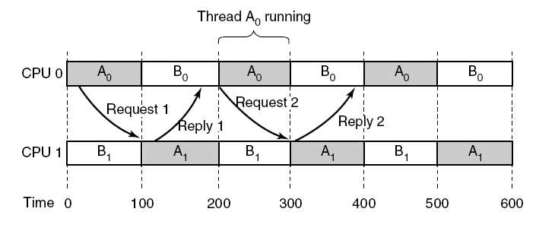
Gang Scheduling (1)
Communication between two threads belonging to thread A that are running out of phase.
Groups of related threads are scheduled as a unit, a gang
All members of a gang run simultaneously on different timeshared CPUs
All gang members start and end their time slices together
Tanenbaum, Modern Operating Systems 3 e, (c) 2008 Prentice-Hall, Inc. All rights reserved. 0-13-6006639
Notes:
13/03/07

Slide 29
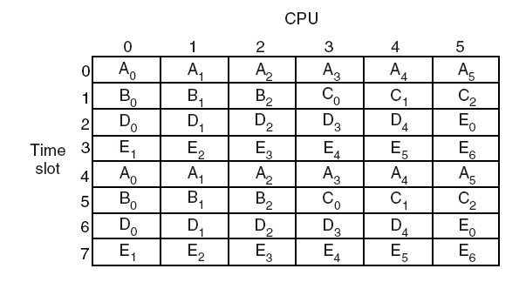
Gang Scheduling (3)
Figure 8-15. Gang scheduling.
Tanenbaum, Modern Operating Systems 3 e, (c) 2008 Prentice-Hall, Inc. All rights reserved. 0-13-6006639
Notes:
13/03/07

Slide 30
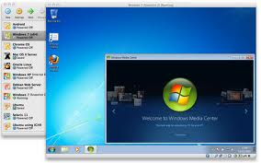
CENG334
Introduction to Operating Systems
        Virtualization
Erol Sahin
Dept of Computer Eng.
Middle East Technical University
Ankara, TURKEY
Notes:
13/03/07

Slide 31
Virtualization - Motivation
Institutions typically have
  Web server
  ftp server
  File server
  Application servers
  ….
All servers typically run on different machines since
  One cannot handle the load
  Reliability
  Security
  Some applications work on different OS’s or different versions of OS’s
Inefficiency
  In hardware
  In power consumption
  In maintenance costs
  ..
Tanenbaum, Modern Operating Systems 3 e, (c) 2008 Prentice-Hall, Inc. All rights reserved. 0-13-6006639
Notes:
13/03/07

Slide 32

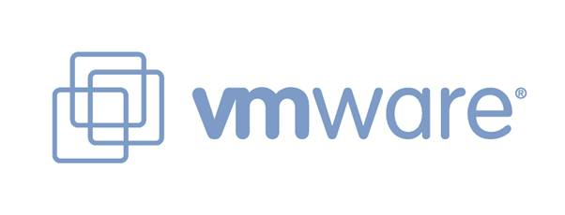


Virtual Machines
A virtual machine takes the layered approach to its logical conclusion. It treats hardware and the operating system kernel as though they were all hardware
A virtual machine provides an interface identical to the underlying bare hardware
The operating system creates the illusion of multiple processes, each executing on its own processor with its own (virtual) memory
Virtualbox.org
parallels.com
Vmware.com
Notes:
18/02/08
21/02/08

Slide 33
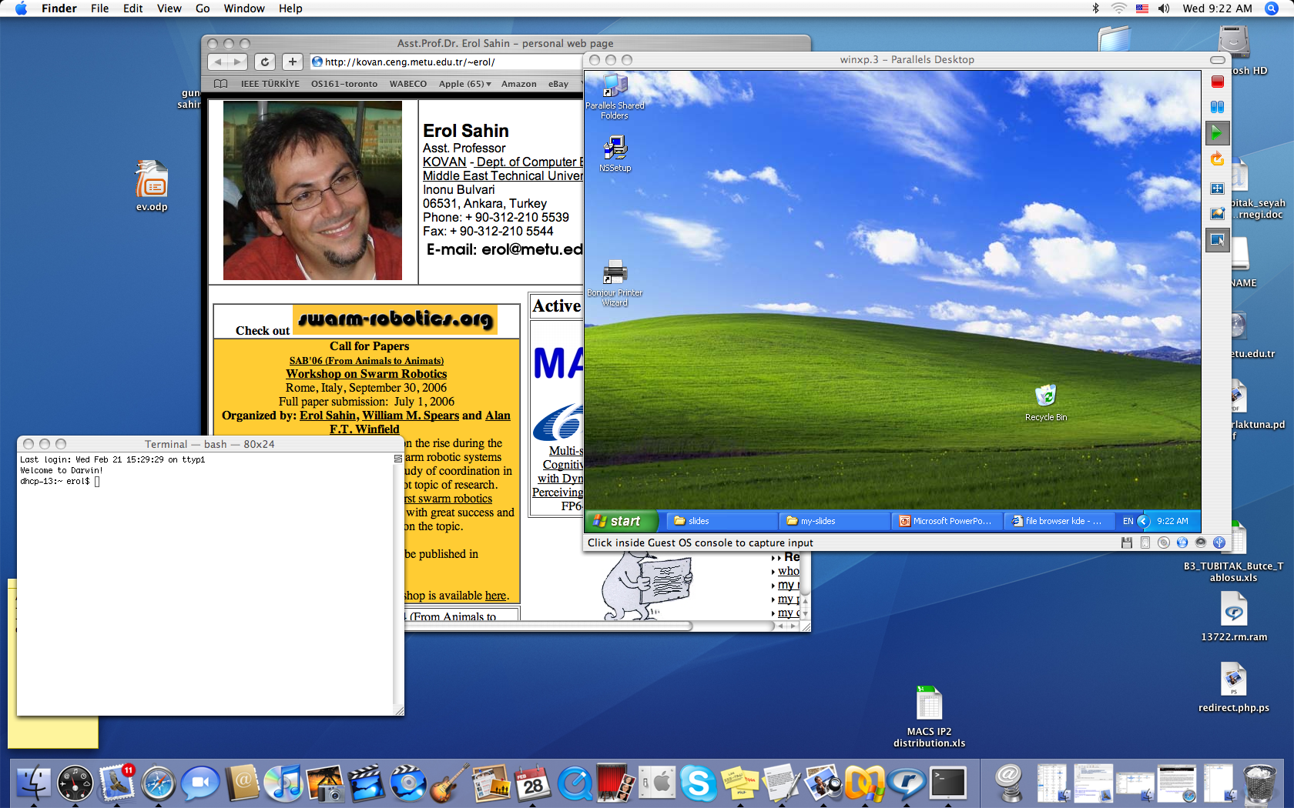
Virtualization
A single computer system hosting multiple virtual machines each potentially running a different OS.
A 40 year old technology dating back to IBM/370 that is making a come-back in the recent years.
Robustness against software failures
Able to run legacy applications on OS’s that are not supported on current hardware or available OS’s.
Good for software development that targets different OS’s.
Tanenbaum, Modern Operating Systems 3 e, (c) 2008 Prentice-Hall, Inc. All rights reserved. 0-13-6006639
Notes:
13/03/07

Slide 34

The Java Virtual Machine
Notes:
18/02/08
21/02/08

Slide 35
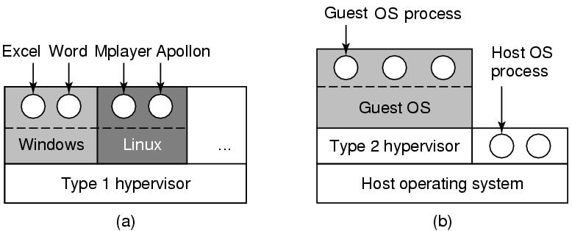
Two approaches
Hardware
Hardware
Virtualization is implemented by hypervisors that act just like the real hardware.
Type 1 hypervisor
  Virtualization is implemented as part of the hosting OS at the kernel level.
  Support multiple copies of the actual machine, called virtual machines.
Type 2 hypervisor
  Virtualization is implemented as a user program running at the user level.
  It “interprets” the machine’s instruction set which also creates a virtual machine.
Notes:
13/03/07

Slide 36
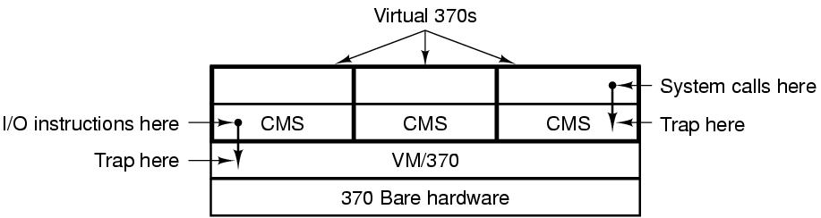
The structure of IBM VM/370
When a CMS program executed a system call, the call is trapped by the CMS (guest OS)
CMS then issued the normal hardware I/O instructions for reading its virtual disk, etcetera.
These I/O instructions were trapped by the VM/370, which then performed them as part of its simulation of the real hardware.
In its modern incarnation, z/VM can run multiple OS’s such as AIX’s or Linux.
Tanenbaum, Modern Operating Systems 3 e, (c) 2008 Prentice-Hall, Inc. All rights reserved. 0-13-6006639
Notes:
13/03/07

Slide 37
Requirements for virtualization
Approach: trap the “privileged instructions” in the user mode
  typically related to kernel functions, such as I/O instructions or instructions that changes MMU settings
  emulate them within the guest OS
Requires help from hardware
  AMD and Intel CPU’s have created virtualization support after 2005
    Containers in which virtual machines can run
    The program runs until it creates a trap
    Traps handled by the hypervisor to emulate the desired behavior
Notes:
13/03/07

Slide 38
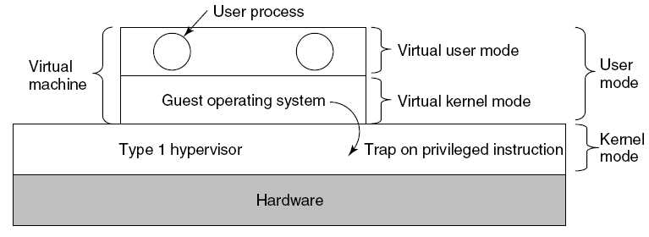
Type 1 Hypervisors
The hypervisor runs on the bare hardware as part of the OS.
The virtual machine runs as a user process in user mode.
  Is not allowed to execute “privileged instructions”.
The guest OS thinks it is running in kernel mode, although it is in user mode. (virtual kernel mode)
When the guest OS executes a “privileged instruction”, it generates a trap (thanks to the VT support from hardware) in the host OS kernel.
The hypervisor inspects the instruction if it was issued by the guest OS running in the virtual machine.
If so, the hypervisor emulates what the real hardware would do when confronted with that “privileged instruction” executed in user mode.
Tanenbaum, Modern Operating Systems 3 e, (c) 2008 Prentice-Hall, Inc. All rights reserved. 0-13-6006639
Notes:
13/03/07

Slide 39
Type 2 Hypervisors
The hypervisor runs as a user process on the host OS.
The virtual machine runs as a user process in user mode.
  Is not allowed to execute “privileged instructions”.
The guest OS thinks it is running in kernel mode, although it is in user mode. (virtual kernel mode)
When the guest OS executes a “privileged instruction”, the hypervisor emulates it.
Tanenbaum, Modern Operating Systems 3 e, (c) 2008 Prentice-Hall, Inc. All rights reserved. 0-13-6006639
Notes:
13/03/07

Slide 40
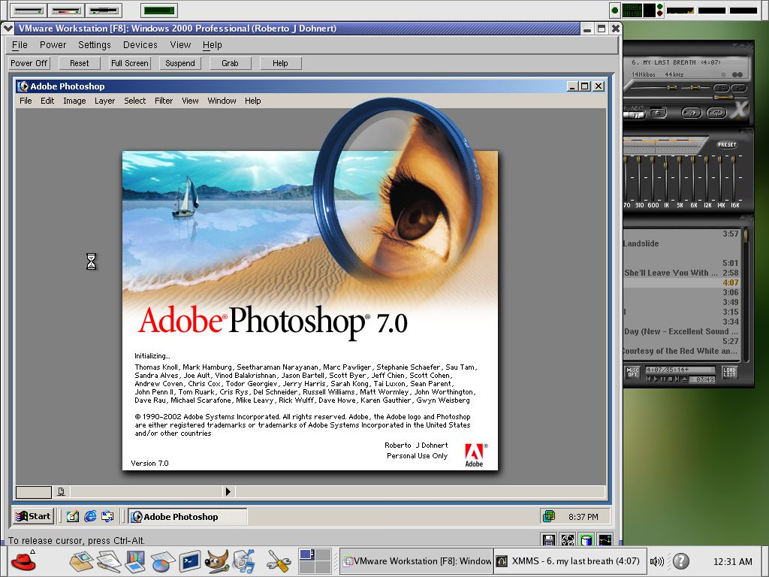
VMware: A case study
VMware runs as a user program on the host OS, such as Windows or Linux.
When it starts it acts like a newly booted computer, and expects to find a CD-ROM containing an OS. It then installs the (guest) OS on a virtual disk.
Once the guest OS is installed on the virtual disk, it can be booted to run.
Notes:
13/03/07

Slide 41

VMware Architecture
Notes:
18/02/08
21/02/08

Slide 42
VMware: A case study
When executing a binary program, it scans the code looking for basic blocks, that is straight runs of instructions ending in a jump, call, trap or other instructions that change the flow of execution.
The basic block is inspected if it contains any “privileged instructions”. If so, each one is replaced with a call to VMware procedure that handles it. The final instruction is also replaced with a call into VMware.
Once these steps are made, the basic block is cached inside VMware, and then executed.
A basic block not containing any “privileged instructions” will execute as fast as it will on a bare machine, because it is running on the bare machine.
“Privileged instructions” that are caught in this way are emulated. This is known as binary translation.
Notes:
13/03/07

Slide 43
VMware: A case study
After the execution of a basic block is completed, the control returns back to VMware, which picks its successor that comes next.
If the successor is already translated, it can be executed immediately.
Eventually, most of the program will be in cache and will run at close to full speed.
There is no need to replace sensitive instructions in user programs. The hardware will ignore them any way.
Notes:
13/03/07

Slide 44
Type I vs Type 2 hypervisors
Unlike what you would expect, Type 1 is not a winner at all times.
It turns our that trap-and-emulate approach creates a lot of overhead due to the handling of the traps (including context switches) and that the binary translation approach (combined with caching of translated blocks) can run faster.
For this reason, some type 1 hypervisors also perform binary translation for speeding up.
Notes:
13/03/07

Slide 45
Paravirtualization
Both type 1 and type 2 hypervisors work with unmodified guest OS’s.
A recent approach is to modify the source code of the guest OS such that it makes hypervisor calls instead of executing “privileged instructions”.
For this the hypervisors have to define an API, as an interface to the guest OS’s.
  But this approach is similar to the microkernel approach.
  A guest OS whose “privileged instructions” are replaced with hypervisor calls is said to be paravirtualized.
Notes:
13/03/07

Slide 46
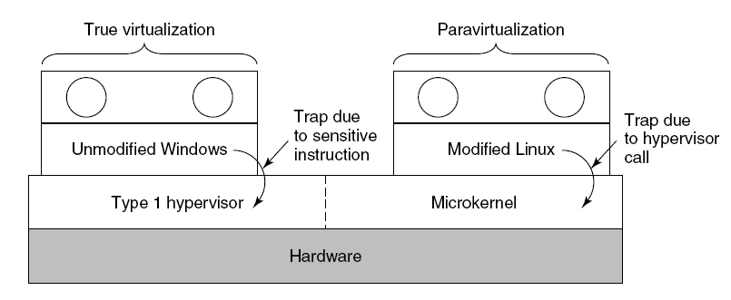
Paravirtualization
A hypervisor supporting both true virtualization and paravirtualization.
Tanenbaum, Modern Operating Systems 3 e, (c) 2008 Prentice-Hall, Inc. All rights reserved. 0-13-6006639
Notes:
13/03/07

Slide 47
Virtualization issues
Memory virtualization
  How to integrate the paging of the host OS with the paging of the guest OS
I/O virtualization
  Do we use the device drivers of the host OS or the guest OS?
Multi-core
  Each core can run a number of virtual machines
  Sharing memory among virtual machines?
Licensing
  Some software is licensed per-CPU basis.
  What is you run multiple virtual machines?
Notes:
13/03/07

